Slide 1
CHAPTER THREE-PART III
Structural Model

Slide 2
Class Diagram
Modelling a system involves identifying the things that are important to your particular view.
These things form the vocabulary of the system you are modelling.
This part explores how we do basic modelling of things and concepts from the real-world
Using Class Diagrams
A class is a definition of objects that share the same properties, relationships and behavior.
An object is an instance of a class(or structure).
The properties of a class are called attributes and the behavior is expressed in operations.

Slide 3
Class Diagram------
Class Diagrams are widely used to describe the types of objects in a system and their relationships.
The relationship can be inheritance, aggregation and association.
The class model also describes the attributes and operations of the class along with the visibility of each.
Class Diagrams model class structure and contents using design elements such as classes, packages and objects.
Class diagrams are used in nearly all object oriented software designs.
They are used to describe the classes of the system and their relationships to each other.
Class diagrams are used to model the static design view of a system
It supports the functional requirements of the system
When we model the static design view of a system,
we will use class diagrams in 3 ways:

Slide 4
Class Diagram------
To model the vocabulary of the system
This involves making a decision about which abstractions are a part of the system under consideration and which falls outside its boundaries.
Class Diagrams are used to specify these abstractions and their responsibilities
2. To model simple collaborations
A collaboration is a society of classes, interfaces, and other elements that
work together to provide some co-operative behaviour that is
bigger than the sum of all the elements
Class Diagrams are used to visualize and specify this set of classes and their relationships.
3. To Model Logical Database Schema
Class Diagrams can also be used to model schemas for databases used to store persistent information

Slide 5
Forward & Reverse Engineering
Even though modelling is important, the primary product of a development team is software, not diagrams
Therefore, it is important that the models we create and the implementations we deploy map to one another
In most cases, the models we create will be mapped to code.
Forward Engineering:
It is the process of transforming a model into code through a mapping to an implementation language

Slide 6
Forward & Reverse Engineering------
2. Reverse Engineering:
It is the process of transforming code into model through a mapping from a specific implementation language
The UML was designed with such mappings in mind
Especially true for class diagrams, whose contents have a clear mapping to object-oriented languages, i.e Java, C++, etc

Slide 7
Class Representation
Each class is represented by a rectangle subdivided into three compartments
Name
Attributes
Operations
Modifiers are used to indicate visibility of attributes and operations, but this is included in class diagram (at Design level).
‘+’ is used to denote public visibility (everyone)
‘#’ is used to denote protected visibility (friends and derived)
‘-’ is used to denote private visibility (no one)
By default, attributes are hidden and operations are visible.

Slide 8
Objects
An object is simply a real-world thing or concept
What are the three essential aspects of objects?
An object has an identity
Can have a name or can be anonymous
2. An object has state
The names of the various properties that describe the object (attributes) and also the value of those attributes
3. An object has behaviour
represented by functions (or methods) that use or change the values of the object’s attributes

Slide 9
Classes
Classes are the most important building block of any object-oriented system
Classes are used : -
To capture the vocabulary of the system you are developing
To represent software things, hardware things, and even things that are purely conceptual
Well-structured classes have crisp boundaries and form a part of a balanced distribution of responsibilities across the system
Class Name
attributes
operations

Slide 10
Name
Every class must have a name to distinguish it from other classes
can be a simple name, i.e. Student, Door, etc
can be a path name-the class name prefixed by the name of the package in which that class lives, i.e. BusinessRecord::Customer,
A class may be drawn showing only its name
Attribute
An attribute is a named property of a class that describes a range of values that instances of the property may hold
It represents some property of the thing you are modelling that is shared by all objects of that class
At any given moment, an object of a class will have specific values for every one of it’s class attributes/ A class may have a number of attributes
Customer

Slide 11
Attributes-----
Attributes may be drawn showing only their names (a)
Or, we can further specify an attribute by stating its type and possibly a default initial value (b)
Customer
name address phone birthdate
Wall
height : Float width : Float thickness : Float isLoadBearing : Boolean = false
(a)
(b)

Slide 12
Attributes-----
Attributes define the properties of the objects:
Every instance of the class has the same attributes
An attribute has a data type
An attribute has visibility (private, protected, public)
The values of the attributes may differ among instances

Slide 13
Operation
An operation is the implementation of a service that can be requested from any object of the class to affect behaviour
Often, invoking an operation on an object changes the object’s data or state
A class may have a number of operations or no operations at all.
Operations may be drawn showing only their names (a)
We can further specify an operation stating its signature (b)
including the name, type and default value of all parameters and (in case of functions) a return type

Slide 14
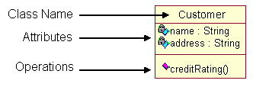
Customer
add() remove() edit()
TemperatureSensor
reset() setAlarm(t : Temperature) value() : Temperature
(a)
(b)
Operations define the behavior of the objects
Action performed on or by an object
Available for all instances of the class
Methods/operations has visibility (private, protected, public)
Need not be unique among classes

Slide 15
Relationships
A relationship is, the logical or physical connections found on class diagrams.
A Link is the basic relationship among objects-represented as a line connecting two or more object boxes.
A link is an instance of an association. In other words, it creates a relationship between two classes.
When we build abstractions, we will discover that very few classes stand alone
Therefore, when we model a system, we must
Identify the things that form the vocabulary of our system (classes)

Slide 16
Relationships------
Model how these things stand in relation to one another
In UML, the ways that things can connect to one another, either logically or physically, are modelled as relationships
In object-oriented modelling, there are three kinds of relationships that are most important
1. Dependencies- represents ‘using’ relationship among classes
2. Generalizations
Connects generalized classes to more specialized ones in what is known as subclass/super-class or child/parent relationship (inheritance)

Slide 17
Relationships------
3. Associations
It represents structural relationships among instances/objects
Each of these relationships provides a different way of combining our abstractions (classes).
The UML provides a graphical representation for each of these kinds of relationships
allows us to visualize relationships
emphasize the most important parts of a relationship: its name, the things it connects, and its properties

Slide 18
A. Dependency
A dependency is a using relationship that states that a change in specification of one thing (independent thing) may affect another thing that uses it (dependent thing), but not necessarily the reverse
It is rendered as a dashed directed line
Dependencies are used in the context of classes to show that one class uses another class as an argument in the signature of an operation.
If the used class changes, the operation of the other class may be affected
The most common kind of dependency relationship is the connection between a class that only uses another class as a parameter to an operation.
dependent
independent

Slide 19
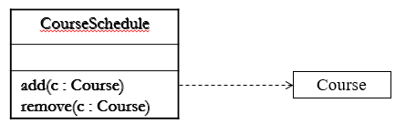
A. Dependency------
To model dependency
Create a dependency pointing from the class with the operation to the class used as a parameter in the operation.
Example: - A system that manages the assignment of students and instructors to courses in a university
There’s a dependency from CourseSchedule to Course, as Course is used in both the add() and remove() operations of CourseSchedule

Slide 20
B. Generalization
It is a relationship between a general thing (superclass or parent) and a more specific kind of that thing (subclass or child)
Generalization means that objects of the child may be used anywhere the parent may appear, but not the reverse
The child is substitutable for the parent
It supports polymorphism
An operation of the child that has the same name/ signature as an operation in a parent overrides the operation of the parent

Slide 21
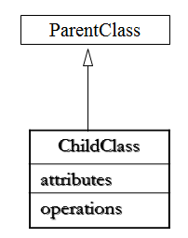
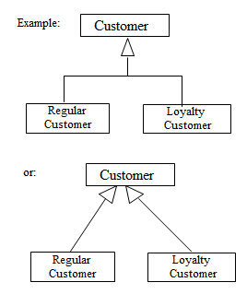
B. Generalization-----
Graphically, a generalization is rendered as a solid directed line with a large open arrowhead, pointing to the parent

Slide 22
B. Generalization--------
A class may have zero, one or more parent
A class that has no parent and one or more children is called a root or base class
A class that has no children is called a leaf class
A class that has exactly one parent is said to use single inheritance
A class that has more than one parent is said to use multiple inheritance
A given class cannot be its own parent
We will often use generalizations among classes and interfaces to show inheritance relationships.
It can also create generalizations with packages

Slide 23
B. Generalization--------
To model inheritance relationship
Given a set of classes, look for responsibilities, attributes and operations that are common to two or more classes
Elevate those common responsibilities, attributes and operations to a more general class.
If necessary, create a new class to which you can assign these elements
Specify that the more-specific classes inherit from the more-general class by placing a generalization relationship that is drawn from each specialized class to its more-general parent

Slide 24
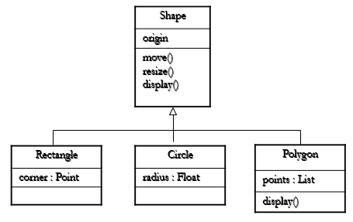
B. Generalization--------
Example: - The Rectangle, Circle and Polygon classes inherits from the attributes and operations of the Shape class

Slide 25
C. Association
An association is a structural relationship that specifies that objects of one thing are connected to objects of another
We can navigate from an object of one class to an object of the other class, and vice versa
Types of association: -
Unary Association- is where both ends of an association circle back to the same class
2. Binary-Association-connects exactly two classes
3. Ternary Association-Connects more than two classes

Slide 26
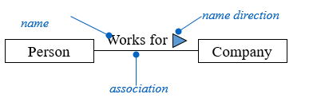
C. Association------
Graphically, an association is shown as a solid line connecting the same or different classes
There are 4 adornments that apply to associations:
Name
An association can have a name to describe the nature of the relationship
A direction can also be given to the name by providing a direction triangle that points in the direction intended (to read the name)

Slide 27
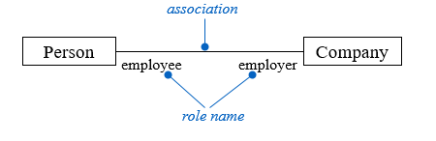
C. Association------
2. Role
When a class participates in an association, it has a specific role that it plays in the relationship
A role is just the face that the class at the near end of the association presents to the class at the other end of the association
An explicit name can be given to the role a class plays in an association

Slide 28
C. Association------
3. Multiplicity
It is important to state how many objects may be connected across an instance of an association
This “how many” is called multiplicity of an association’s role
It is written as an expression that evaluates to a range of values or an explicit value/ Multiplicity can be written as multiplicity of:
Exactly one (1)
Zero or one (0..1)
Many (*)

Slide 29
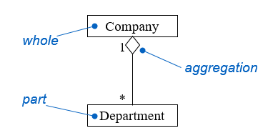
D. Aggregation
It is a “whole-part” relationship within which one or more smaller class are “part” of a larger “whole”
It represents a “has-a” relationship, whereby an object of the whole class has objects of the part

Slide 30
Modelling Relationships
When modelling relationships in the UML
Use dependencies only when the relationship is not structural
Use generalization only when the relationship is an “is-a-kind-of” or inheritance relationship
Beware of introducing cyclical generalization relationships
Keep generalization relationships generally balanced where the level of inheritance should not be too deep
Use associations only when there are structural relationships among objects

Slide 31
Simple Example: To Model a Class Diagram
On-line Bookstore Review
A web application that can be accessed by the store’s registered customer, whereby each customer can review one or more books sold in the book store. Each registered customer has an account that is used to verify his/her ID and password. And Each registered customer, upon account verification, can review one or more books based on its title.
The process given: -
Each registered CUSTOMER has an ACCOUNT that is used to verify his/her ID and password

Slide 32
Simple Example: To Model a Class Diagram------
Each PASSWORD entered must be more than 8 characters and consists of a combination of text and numbers
Each registered CUSTOMER, upon ACCOUNT verification, can REVIEW one or more BOOKs based on its title
A REVIEW can either be a customer’s review and editor’s review
Identify the things found in the problem
Account
Password
Customer
Book
Review
can be divided into CustomerReview and EditorialReview

Slide 33
Simple Example: To Model a Class Diagram------
2. Define the responsibilities of each class
Account
Used to keep the customer’s ID and password for verifying that the customer is a registered customer
Also keeps additional information, i.e. e-mail address
The password is of the type PASSWORD
Password
Used to check that the password entered is valid (more than 8 characters and consists of combination of text and numbers)
Customer
Used to keep information about the customer, such as customer’s name, ID, address etc

Slide 34
Simple Example: To Model a Class Diagram------
Book
Used to keep the relevant information on the book that is crucial to customer’s review, i.e. book title, author, rating
Review
Divided into sub-classes: CustomerReview and EditorialReview
CustomerReview
Used to assign ratings to book reviewed (with 1 being the lowest and 5 the highest) by customer
Used to compute the average rating for each book that has been reviewed by customer
EditorialReview
Used to store editor’s review

Slide 35
Simple Example: To Model a Class Diagram------
3. Translate the responsibilities for each class into attributes and operations needed to perform those responsibilities.
Account
Attributes: emailAddress(string), ID(string), passwd(Password)
Operations: verifyPassword(p: Password)
Password
Attributes: passwd(string)
Operations: checkPassword()
Customer
Attributes: CustName, CustAddress, CustID etc
Operations: NONE

Slide 36
Simple Example: To Model a Class Diagram------
Can choose not to show the attributes when modeling the class as they are not relevant to the given problem (put NONE for both)
Book
Attributes: title, author, rating
Operations : NONE
Review
Attributes: NONE
Operations: NONE
CustomerReview
Attributes: NONE
Operations: assignRatings(rating : Int), computeAvgRating() : double

Slide 37
Simple Example: To Model a Class Diagram------
EditorialReview
Attributes: NONE
Operations: NONE
4. Determine the relationship between classes: -
Dependency
The operation verifyPassword in Account class has as parameter a Password class
Therefore, Account depends on Password
Generalization
Review can be divided into customer’s review and editor’s review

Slide 38
Simple Example: To Model a Class Diagram------
Therefore, CustomerReview and EditorialReview is the subclass of Review
Association
A customer can open 1 account and an account can be opened by 1 customer
A customer writes a review and a review can be written by a customer
1 customer can write 1 or many reviews, but 1 review can only come form 1 customer
A book can have many reviews but a review is for one book

Slide 39
5. Modelling the classes Diagram
EditorialReview
Book
title : String
has
Review
1
*
writes
is written by
CustomerReview
assignRating(rating : Int) computeAvgRating() : Double
Customer
1
1..*
1
opens
1
Account
emailAddress : string ID : string passwd : Password
verifyPassword(p : Password)
Password
pass : String
checkPassword()

Slide 40
Object Diagrams
YOUR READING ASSIGNMENT

Slide 41
Object Diagrams
Object diagrams model the instances of things contained in class diagrams
An object diagram shows a set of objects and their relationships at a point in time
You use object diagrams to model the static design view or static process view of a system.
involves modelling a snapshot of the system at a moment in time and rendering a set of objects, their state, and their relationships

Slide 42
The UML notation for an object takes the same form as that for a class, except for 3 differences:
Within the top compartment of the class box, the name of the class to which the object belongs to appears after a colon :
The object may have a name that appears before the colon, or it may be anonymous (no name before the colon)
The contents of the top compartment are underlined for an object.
Each attribute defined for the given class has a specific value for each object that belong to that class.
Object : Class
attribute1 = value
attribute2 = value
: Class
attribute1 = value
attribute2 = value
named object
anonymous object

Slide 43
Object diagrams commonly contain
objects
links
may contain notes and constraints
may also contain packages or subsystems, both of which are used to group elements of your model into larger chunks
You use object diagrams to model the static design view or static process view of a system just as you do with class diagrams, but from the perspective of real or prototypical instances
Supports the functional requirements of a system

Slide 44
Example: From the class diagram given below, you can get several instances of it.
Author
Book
name : String
wrote
title : String
rating: Double
published by
Publisher
name : String

Slide 45
: Author
: Book
name : “Margeret Mitchell”
wrote
title : “Gone With the Wind”
rating: 4.5
published by
AW: Publisher
name : “Hawthorne”
Object diagram

Slide 46
: Author
: Book
name : “Tim Burton”
wrote
title : “Burton on Burton”
rating: 4
published by
AW: Publisher
name : “Barnes”
Object diagram

Slide 47

Interaction Diagram: Expressing How Things Work Together
3. Sequences Diagram

Slide 48
Modelling an Interaction
When modelling an interaction, we need to include
both objects and messages
Each object plays a specific role
Each message represents the communication between objects,
with some resulting action
These dynamic aspect may involve : -
The interaction of any kind of instance in any view of
a system’s architecture, including instances of a class, interface, components and nodes.
A system as a whole, a subsystem, an operation or a class.

Slide 49
Modelling an Interaction---------
An interaction diagram can be used in two ways: -
To model flows of control by time ordering
Emphasizes the passing of messages as they unfold over time- Sequence Diagram is used to model this
To model flows of control by organization
Emphasizes the structural relationships among the instances in the interaction, along which messages may be passed- Collaboration Diagram is used to model this

Slide 50
3. Sequences Diagram
A sequence diagram is an interaction diagram that emphasizes the time ordering of messages
Build sequence diagram for each use cases
But if you think that some use cases are clear to understand you may not need to develop a sequence diagram, you need to explain this explicitly
Sequence Diagram is used to visualize the logic inside use cases.
You built sequence diagrams or collaboration diagrams from the use-case and class diagrams that were built before.

Slide 51
3. Sequences Diagram----------
Each use cases in a use-case diagram has its corresponding sequence or collaboration diagram
A sequence diagram has four key elements: -
Objects appear along the top margin
Lifeline, which is a dashed line that represent the life and perhaps death of the object
3. A focus of control, which is a tall thin rectangle that sits on top of an object’s lifeline
It shows the period of time during which an object is performing an action, either directly or through subordinate procedure
The bottom part of a focus of control can be marked by a return message
4. Messages show the actions that objects perform on each other and on themselves.
You model the diagrams from the main flow of events, or the alternate flow of events, or the scenarios, of each use case

Slide 52
3. Sequences Diagram======
Every object that you have identified in the sequence or collaboration diagram, MUST have its corresponding class in the class diagram
To Model a Sequence Diagram: -
Set the context for the interaction
Whether it is a system, subsystem, operation, class or a scenario of a use case or collaboration
Identify which objects play a role in the interaction
Place them from left-to-right, at the top of the diagram
Set the lifeline for each object

Slide 53
Messages & Actions
A message is a communication between two objects, or within an object, that is designed to result in some activity.
This activity involves one or more actions, which are executable statements that result in
Changes in the values of one or more attributes of an object, or
The return of some value(s) to the object that sent the message, or both.
There are 5 kinds of actions that the UML explicitly supports:
Call and Return
Create and Destroy
Send

Slide 54
A. Call Action: A call action invokes an operation on an object
It is synchronous, meaning that the sender assumes that the receiver is ready to accept the message,
And the sender waits for a response from the receiver before proceeding
The UML represents a call action as an arrow from the calling object to the receiving object
: Class
Object: Class
A call action that involves two objects
action name
A lifeline
action name
A call action from an object to itself

Slide 55
B. Return Action
A return action is the return of a value to the caller, in response to a call action
The UML represents a return action as a dashed arrow from the object returning the value to the object receiving the value
: Class
Object: Class
return value

Slide 56
Example :- Call and Return action
: Customer
: CustomerReview
assignRating()
computeAvgRating()
average rating

Slide 57
C. Create Action
A create action creates an object
It tells a class to create an instance of itself
In the UML, create action is represented as an arrow with the stereotype <<create>> from the object that invokes the create action to the created object
Object: Class
: Class
Object: Class
<<create>>
<<create>>
: Class
Alternate Create Action notation

Slide 58
D. Destroy Action :A destroy action destroys an object
It tells an object to destroy itself
An object can perform a destroy action on another object, or on itself
In the UML, a destroy action is represented as an arrow with the stereotype <<destroy>> from the object that invokes the action to the destroyed object.
A large X is also added at the end of the destroy arrow to denote that the object’s lifeline has been terminated
Object: Class
: Class
<<destroy>>
X

Slide 59
E. Send Action
A send action sends a signal to an object
A signal is an asynchronous communication between objects
One object “throws” a signal to another object that “catches” the signal
The sender of the signal does not expect a response from the receiver (unlike the sender of a call action)
Exceptions are the most common type of signals
In the UML, a send action is represented as an arrow with a half arrowhead at the lifeline of the receiving object
: Class
Object: Class
action name

Slide 60
Modelling Sequence Diagram
Where is the starting point to built sequence diagrams or collaboration diagrams- Use-Case and Class Diagrams.
Each use cases in a use-case diagram has its corresponding sequence or collaboration diagram
You model the diagrams from the main flow of events, or the alternate flow of events, or the scenarios, of each use case
Every object that you have identified in the sequence or collaboration diagram, MUST have its corresponding class in the class diagram.
Example: - Modelling a sequence diagram for the log-in use case from the on-line Bookstore Case Study.

Slide 61
Modelling Sequence Diagram --------
The main-flow of events that are involved is: -
The CUSTOMER clicks the Log-in button on the Home Page.
The system displays the Log-in Page.
3. The CUSTOMER enters his/her user ID and password. The CUSTOMER clicks the OK button.
4. The system validates the log-in information against the ACCOUNT table in the database.
5. CUSTOMER is an authorised user; the system displays the Personal Home Page to the CUSTOMER

Slide 62
Modelling Sequence Diagram --------
Actors: Customer
Messages and Objects
The CUSTOMER clicks the Log-in button on the Home Page.
The system displays the Log-in Page.
The CUSTOMER enters his/her user ID and password. The CUSTOMER clicks the OK button.
The system validates the log-in information against the ACCOUNT table in the database.
CUSTOMER is an authorised user; the system displays the Personal Home Page to the CUSTOMER

Slide 63
The Customer clicks the Login button on the Home Page
The system displays the Login Page
The Customer enters his or her user ID and password, and then clicks the OK button.
The system validates the login information against the persistent Account data and then returns the Customer to the Home Page.
:Customer
:HomePage
:LoginPage
:Account
clickLogin( )
display( )
enter userID and password
clickOK( )
validateLogin(userID, password)
login OK
display( )
Sequence Diagram

Slide 64
There are 3 types of analysis classes:
Boundary Class
Entity Class
Control Class
Instances of each of these analysis classes are called objects.
1. Boundary Objects
is an object with which an actor associated with a use case interacts.
If the actor is human, the boundary object may be a window, screen, dialog box, or menu
If the actor is non-human, the boundary object may be Application Program Interfaces (APIs)
Boundary Object

Slide 65
2. Entity Objects
is an object that contains long-lived information, such as that associated with databases.
will be mapped to a table (part of the database) in the design phase
It can also contain transient objects, i.e. contents of lists in windows, or search results.
Entity Object

Slide 66
3. Control Objects
is an object that embodies (represents) application logic
Correspond with system actions (not actions taken by actors)
are often used to handle things such as coordination and sequencing
are also useful for calculations involving multiple entity objects
will be mapped to codes during implementation phase
used as a connecting tissue between boundary objects and entity objects.
Using the previous example (the log-in use case of the Online Bookstore), we can identify that:
HomePage and Log-in Page objects are boundary objects,
Account object is an entity object.
Therefore, taking this into account, we can draw a new Sequence diagram.
Control Object

Slide 67
The Customer clicks the Login button on the Home Page
The system displays the Login Page
The Customer enters his or her user ID and password, and then clicks the OK button
The system validates the login information against the persistent Account data …… and then returns the Customer to the Home Page.
.
:Customer
:HomePage
:LoginPage
:Account
clickLogin( )
display( )
enter userID and password
clickOK( )
validateLogin(userID, password)
login OK
display( )
Sequence Diagram

Slide 68
Simple Example
On-line Bookstore is a web application that can be accessed by the store’s registered customer, whereby each customer can order books, review one or more books sold in the book store, and sell used books to other customers. Before performing any one of these transactions, the customer must first log-in into the system using their user id and password kept in their account.
Problem: Draw the sequence diagram for the above system.
From previous discussions, we know that the functional requirements for the Online Bookstore can be seen from the use case diagram (as shown in the next slide)
Each of the use cases in the use case diagram must have its corresponding interaction diagram
We will use the scenarios in the ‘Main flow of events’ for each use case to model the interaction diagram

Slide 69
On-line Bookstore System
Register
<<extend>>
(CustID)
Check out
Customer
Order books
<<include>>
<<include>>
Sell used books
Log-in
<<include>>
Use Case Functional Requirements Diagram
Review books

Slide 70
Use Case: Register
Main flow of events:
1. The CUSTOMER clicks the REGISTER button on the Home Page.
2. The system displays the Register Page.
3.The CUSTOMER enters all of the required information.
4. The CUSTOMER clicks the SEND button.
5. The system checks that all of the required information were entered.
If yes, the system update the CUSTOMER’s record in the CUSTOMER and ACCOUNT tables in the database. System displays OK message.
Objects:-
CUSTOMER: actor
CUSTOMER and ACCOUNT: Entity Objects
Home Page and Register Page: Boundary Objects

Slide 71
Register
:Customer
:HomePage
:RegisterPage
The customer clicks the REGISTER button on the Home Page
clickRegister( )
The system displays the Register Page
display( )
The Customer enters the required information and then clicks the SEND button.
enter information
clickSEND( )
verify info
The system checks that all of the required information were entered. If yes, the system updates the CUSTOMER’s record in the CUSTOMER and ACCOUNT tables in the database. The system displays OK message
<<create>>
:Account
<<create>>
:Customer
display( )

Slide 72
Use Case: Order Books
Main Flow of events: -
1. The CUSTOMER enters the keyword for a book and clicks the SEARCH button on the personal Home Page.
2. The system displays the matching books on the web Page.
3. The CUSTOMER chooses the desired book and clicks the ADD TO SHOPPING CART button on the web page.
4. The system adds the book into the CUSTOMER’s Order table in the database.
Objects:
Customer: actor
Home Page: boundary object
Book and Order: entity object

Slide 73
Order books
:Customer
:HomePage
:Book
:Order
The CUSTOMER enters the keyword for a book and clicks the
SEARCH button on the personal Home Page
enters keyword
clickSearch( )
search( )
The system displays the matching books on the web Page
displayMatch( )
The CUSTOMER chooses the desired book and clicks the ADD TO SHOPPING CART button on the web page.
choose books
clickAdd()
<<create>>)
The system adds the book into the CUSTOMER’s Order table in the database.
addBook( )

Slide 74
Use Case: Check-out
Main flow of events
1. The CUSTOMER clicks the Check out button on the Home Page
2. The system displays the books in the ORDER table of the CUSTOMER on the web Page.
3. The CUSTOMER checks the order list for any inconsistency. If nothing was found, CUSTOMER clicks the PROCEED button.
4. The system displays the Invoice page.
5. The Customer enters the relevant credit card information and clicks OK.
6. The system checks that the credit card is valid. Then, the system displays the Delivery Details page.
7. The CUSTOMER chooses destination for delivery, along with delivery options. Then, he/she clicks the PROCEED button.
8. The system will display the check-out information for confirmation.
8. The CUSTOMER checks that all information is correct and then clicks the OK button.
9. The system sends a confirmation via CUSTOMER’s e-mail.
Identify Objects: -

Slide 75
:Customer
:HomePage
:Order
:InvoicePage
:Customer
:DeliveryPage
clickCheckOut( )
retrieve()
display( )
verify info
clickProceed( )
display( )
enter credit card info
clickOK()
validate( )
display( )
choose destination
clickOK()
display()
confirm and clickOK ()

Slide 76
Use case: Sell used books
Main flow of events: -
1. The CUSTOMER clicks the Sell Used Books button on the Home Page.
2. The system displays the sell used books web page.
3. The CUSTOMER enters the required information on the used books that he/she wants to sell.
4.The CUSTOMER clicks the SEND button on the webpage.
5.The system displays a confirmation page listing the information that the CUSTOMER has entered.
6. The CUSTOMER checks that the information displayed are accurate. If yes, the CUSTOMER clicks the OK button on the web page.
7. The system updates the USED BOOKS table in the database.
Objects:
Home Page, Used Books Page and Confirmation Page: boundary objects
Customer and Used Books: entity objects

Slide 77
Sell used books
:Customer
:HomePage
:UsedBooksPage
:ConfPage
:Customer
:UsedBook
clickUsedBooks( )
display( )
enter book info
clickSend( )
display( )
verify info
clickOK( )
add( )
add( )

Slide 78
Use case: Review
Main flow of events: -
1. The CUSTOMER enters the keyword to search for a book and then clicks the SEARCH button on the Personal Web Page.
2. The system displays the matching books on the web Page.
3. The CUSTOMER checks for the desired book and clicks on the chosen book icon.
4. The system displays the book’s detail in the Book Detail web page.
5. The CUSTOMER clicks the REVIEW button on the web page.
6. The system displays the Review Book web page.
7. The CUSTOMER clicks on the desired star button and the click the OK button on the web page.
8. The system calculates the overall rating of the book and updates the Book table in the database.
9. The system displays the Book Detail web pages that have been updated.
Identify all Objects and Draw the Sequence Diagram for the above flow of events?

Slide 79
Activity Diagram

Slide 80
Activity Modeling
An activity diagram is a behavioral diagram that illustrates the flow of activities or actions within a system or process.
It is one of the Unified Modeling Language (UML) diagrams used to model the dynamic aspects of a system.
Activity diagrams are particularly useful for modeling business processes, workflows, and system behaviors.
They provide a visual representation of the sequence of actions, decision points, and concurrency within a process.
Activity diagrams describe the workflow behavior of a system.
They are typically used for modeling:
Business process,
The logic captured by a single use case or usage scenario, or
The detailed logic of a business rule.
UML activity diagrams could potentially model the internal logic of a complex operation.
In many ways UML activity diagrams are the object-oriented equivalent of flow charts.

Slide 81
4. Activity Modeling--------
Activity diagrams do not give detail about how objects behave or how objects collaborate.
Diagrams are read from top to bottom and have branches and forks to describe conditions and parallel activities.
A fork is used when multiple activities are occurring at the same time.
Activity diagrams show the sequence of activities in a process, including sequential and parallel activities.
Symbols are used for activities, decisions and so on.
Arrows represent events that connect the activities.

Slide 82
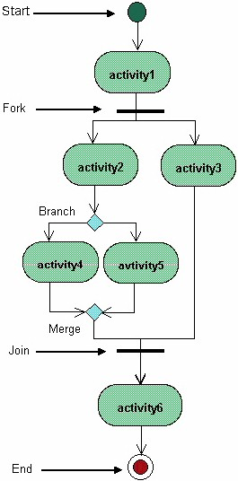

Slide 83
4. Activity Modeling--------
The diagram above shows a fork after activity1.
This indicates that both activity2 and activity3 are occurring at the same time.
After activity2 there is a branch.
The branch describes what activities will take place based on a set of conditions.
All branches at some point are followed by a merge to indicate the end of the conditional behavior started by that branch.
After the merge all of the parallel activities must be combined by a join before transitioning into the final activity state.

Slide 84
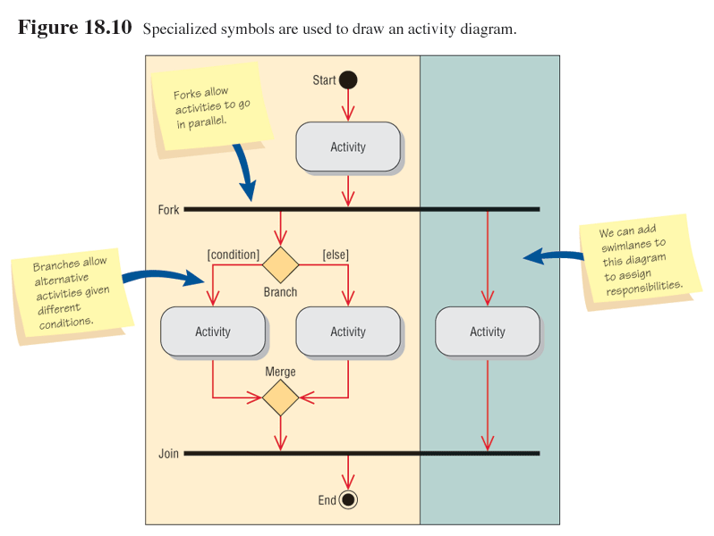
Activity Diagram Symbols

Slide 85
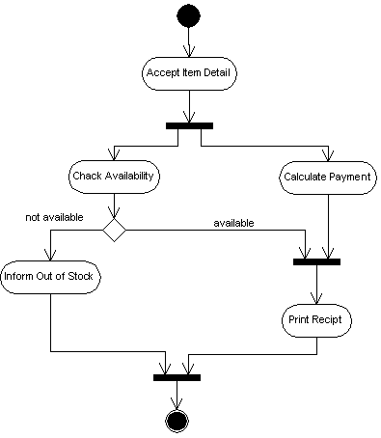
Example:-Activity of performing selling an item to a customer.

Slide 86
Modeling Activity Diagrams
Ask what happens first, second, and so on.
Determine if the activities happen in sequence or parallel.
Examine all the scenarios for a use case.
Swimlanes
Included on activity diagrams to show partitioning
Show which activities:
Occur on a browser
Occur on a server
Happen on a mainframe
Are done by external partners
Help to divide tasks among team members

Slide 87
Swimlane Boundaries
When an event crosses swimlane boundaries, data must be transmitted.
A Web form is sent to a server.
Data are placed into middleware to transmit it between a server and a mainframe.
Data are transmitted to and from an external partner.

Slide 88
More on Activity Diagrams
An activity diagram is like a state diagram.
Except most transitions are caused by internal events, such as the completion of a computation.
An activity diagram:
Can be used to understand the flow of work that an object or component performs.
Can also be used to visualize the interrelation and interaction between different use cases.
Is most often associated with several classes.
One of the strengths of activity diagrams is the representation of concurrent activities.

Slide 89
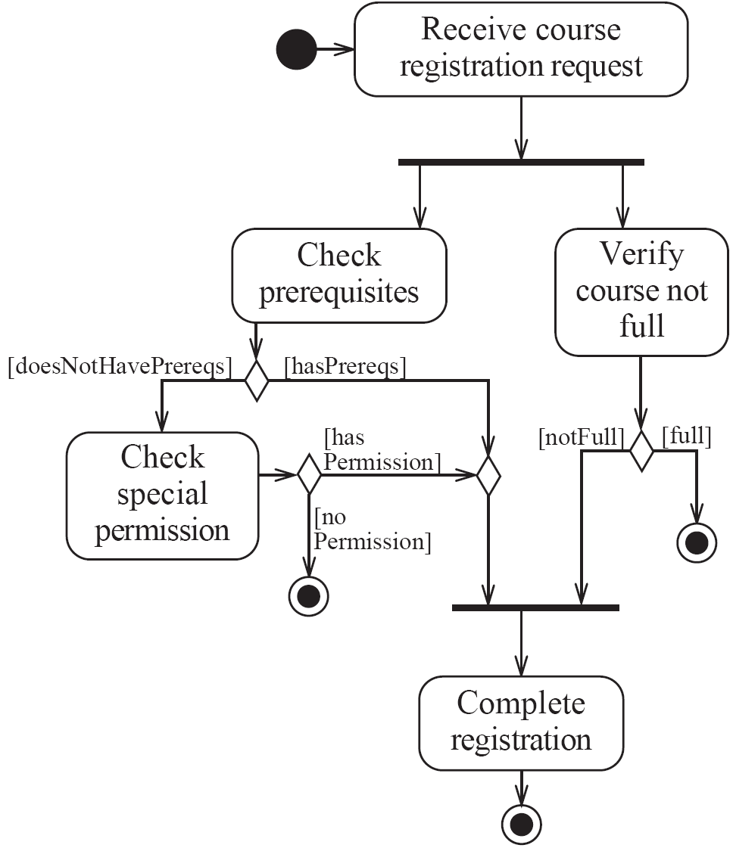
Activity diagrams – an example

Slide 90
Representing concurrency
Concurrency is shown using forks, joins and rendezvous.
1. A fork has one incoming transition and multiple outgoing transitions.
The execution splits into two concurrent threads.
2. A rendezvous has multiple incoming and multiple outgoing transitions.
Once all the incoming transitions occur all the outgoing transitions may occur.

Slide 91
Continued---
3. A join has multiple incoming transitions and one outgoing transition.
The outgoing transition will be taken when all incoming transitions have occurred.
The incoming transitions must be triggered in separate threads.
If one incoming transition occurs, a wait condition occurs at the join until the other transitions occur.
Swimlanes
Activity diagrams are most often associated with several classes.
The partition of activities among the existing classes can be explicitly shown using swimlanes.

Slide 92
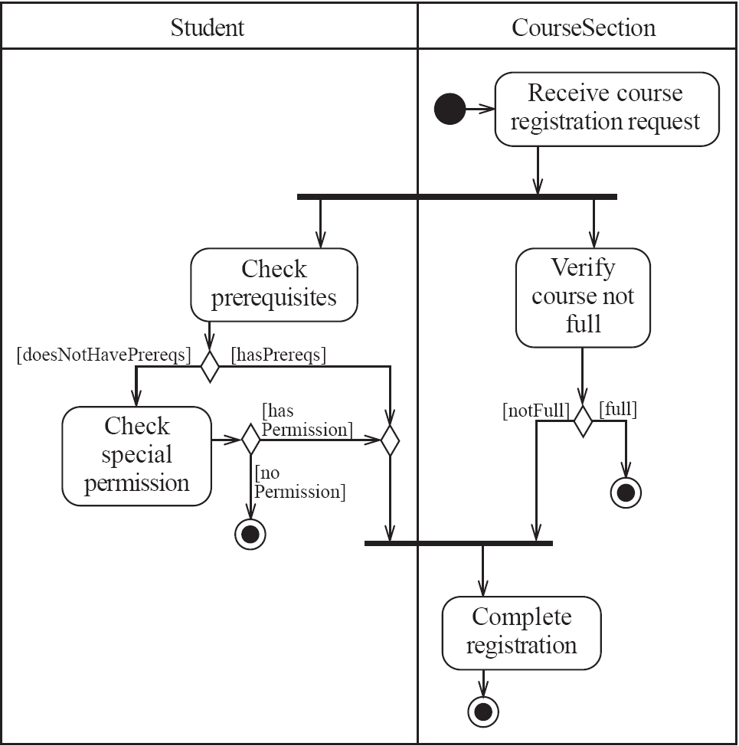
Activity diagrams – an example with swimlanes

Slide 93
Note
Activity diagrams are helpful for visualizing the sequence of steps in a process, identifying decision points and parallel activities, and understanding the overall flow of control. They are widely used in software development, business process modeling, and system analysis to document and communicate complex processes in a clear and understandable manner.

Slide 94
UI Prototyping
Is an iterative analysis task in which users are actually participating in mocking up of the UI for a system
Steps
Determine the need (from essential UI model which was on a paper)
Build the prototype using tools like HLL
Consider the platform (web based – HTML or Window based – VB)
Evaluate the prototype
By the SME

